Slide 1
Movie Extraction, Analysis, & Prediction
Made by: Nilesh Popli
Guided by: Dr. Sharon Christa

Slide 2
Introduction
Tech Stack
Methodology
Scraping
Predicting Genre from Movie Posters
Predicting Genre from Movie Synopsis
Predicting Rating from Movie Reviews
Website GUI
Conclusion
Future Work

Slide 3
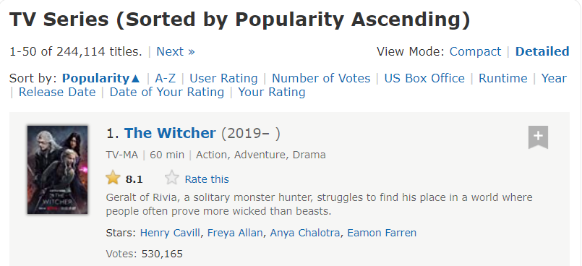
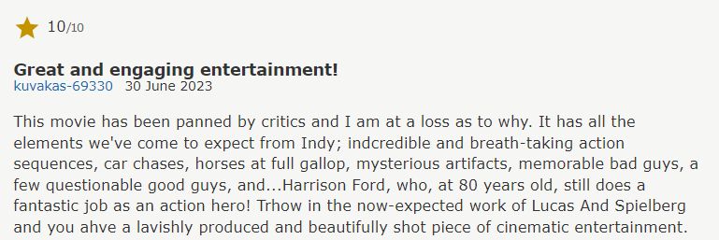
Movies are an integral part of our lives. They entertain us, make us laugh, cry, and even inspire us. But have you ever wondered how movie genres are determined? Is it just based on the storyline or something else?
In this presentation, we will explore how we can use data and machine learning to analyze and predict movie genres.
Specifically, we will look at how we scraped the top 10000 movies from IMDB and created datasets to train our models.
It can help filmmakers better understand their audience and create movies that resonate with them. It can also help movie distributors and streaming platforms recommend movies to users based on their preferences.
Introduction

Slide 4
Programming Language: Python. HTML, CSS
Libraries/Modules: Beautiful Soup, Requests, Pandas, TensorFlow, Keras, NumPy, Matplotlib, OpenCV, scikit-learn, NLTK, Selenium
Data Storage: CSV format (Pandas library can be used to handle CSV data)
Application: Jupyter Notebook
Integration: Flask
Tech Stack

Slide 5
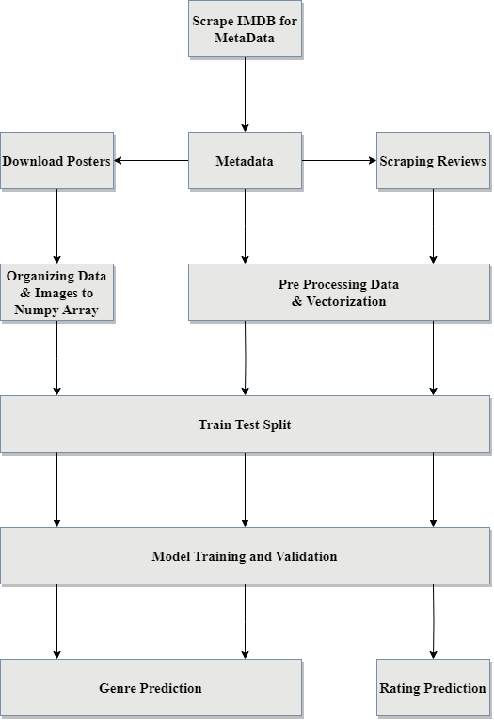
Methodology

Slide 6
Metadata: Utilize BeautifulSoup library and other techniques to extract information from IMDB's top 10,000 movies. Collect data such as movie title, release year, duration, synopsis, and user reviews, certification, etc. and combine the scraped data to create a comprehensive dataset of 10,000 movies, which acts as the metadata Dataset.
Downloading Posters: Download movie posters using the dataset created in step 1 and store the downloaded posters for further analysis and visual representation
Download User Reviews: For each movie in the original dataset create a CSV file containing reviews, ratings, and user details for each movie and combine all movie reviews into a single dataset for further analysis.
Scraping

Slide 7
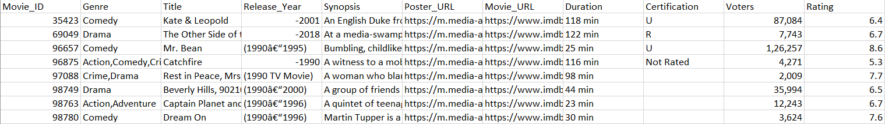
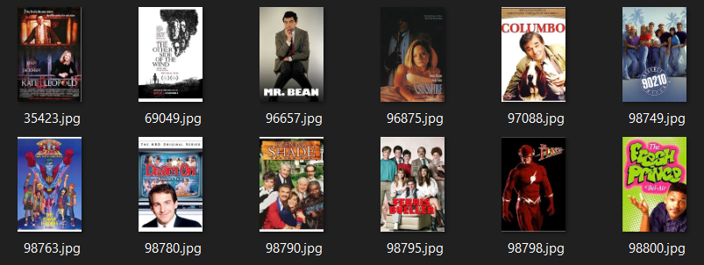
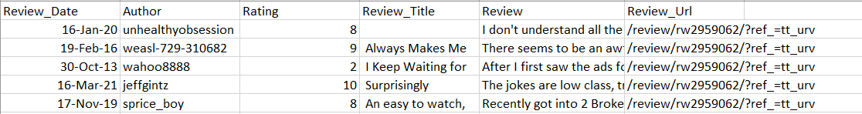
DataSets

Slide 8
Organizing the Posters: Preprocess the poster images, converting them into Numpy arrays and split the downloaded movie posters into training, testing, and validation sets.
Training Model: Utilize Keras deep learning library to train a custom genre classification model, and a pretrained VGG Model and optimize the model using appropriate loss functions and optimizers.
Prediction: Given a random movie, obtain its poster image and then utilize the trained model to predict the genre based on the poster features.
Genre from Posters

Slide 9
Preprocessing: Clean and preprocess the movie synopsis, removing stop words and special characters, perform tokenization and stemming to reduce word complexity and enhance feature extraction.
Vectorization: Apply TF-IDF to convert the textual data into numerical feature vectors. Represent each movie's synopsis as a weighted vector of its keywords.
Training: Utilize the TF-IDF vectors to train classification models such as Support Vector Machines (SVM) and Multinomial Naive Bayes.
Predict: Given a random movie synopsis, preprocess it & convert it into a TF-IDF vector and utilize the trained models to predict the genre based on the synopsis.
Genre from Synopsis

Slide 10
Preprocessing: Clean and preprocess the movie reviews, removing stop words and special characters, perform tokenization and stemming to reduce word complexity and enhance feature extraction.
Vectorization: Apply TF-IDF to convert the textual data into numerical feature vectors. Represent each movie’s reviews as a weighted vector of its keywords.
Training: Utilize the TF-IDF vectors to train classification models such as Logistic Regression etc
Predict: Given a random movie review, preprocess it & convert it into a TF-IDF vector and utilize the trained models to predict the rating based on the reviews.
Rating from Reviews

Slide 11
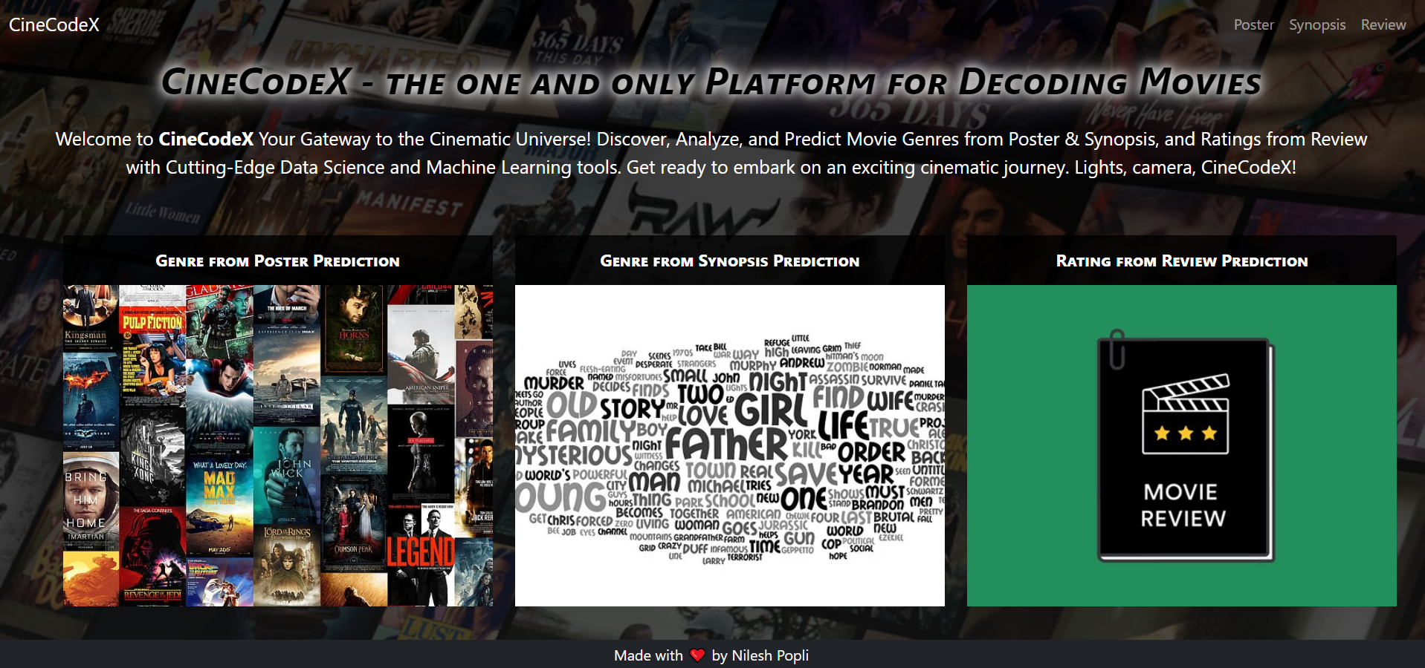
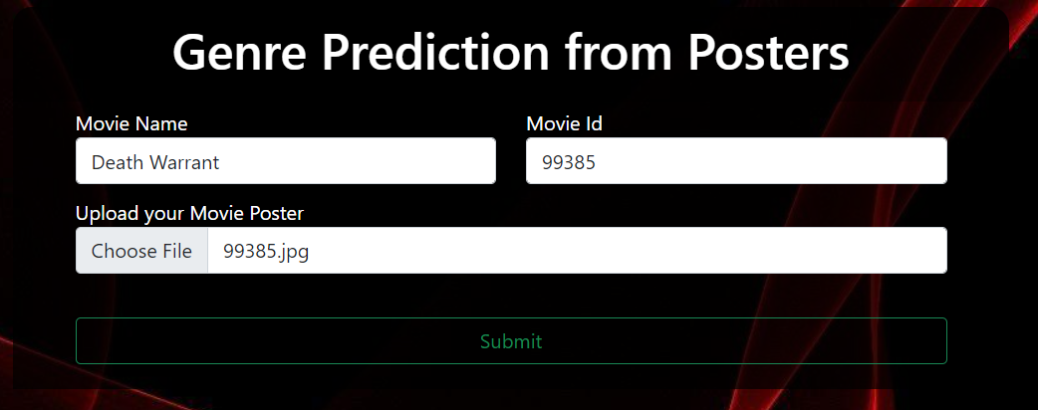
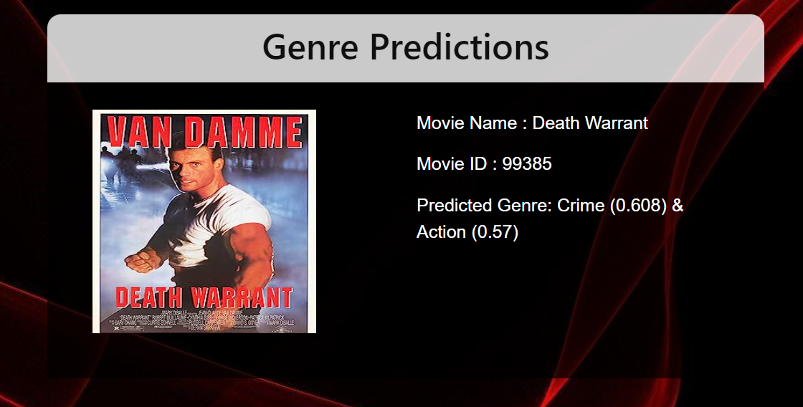
Website GUI

Slide 12
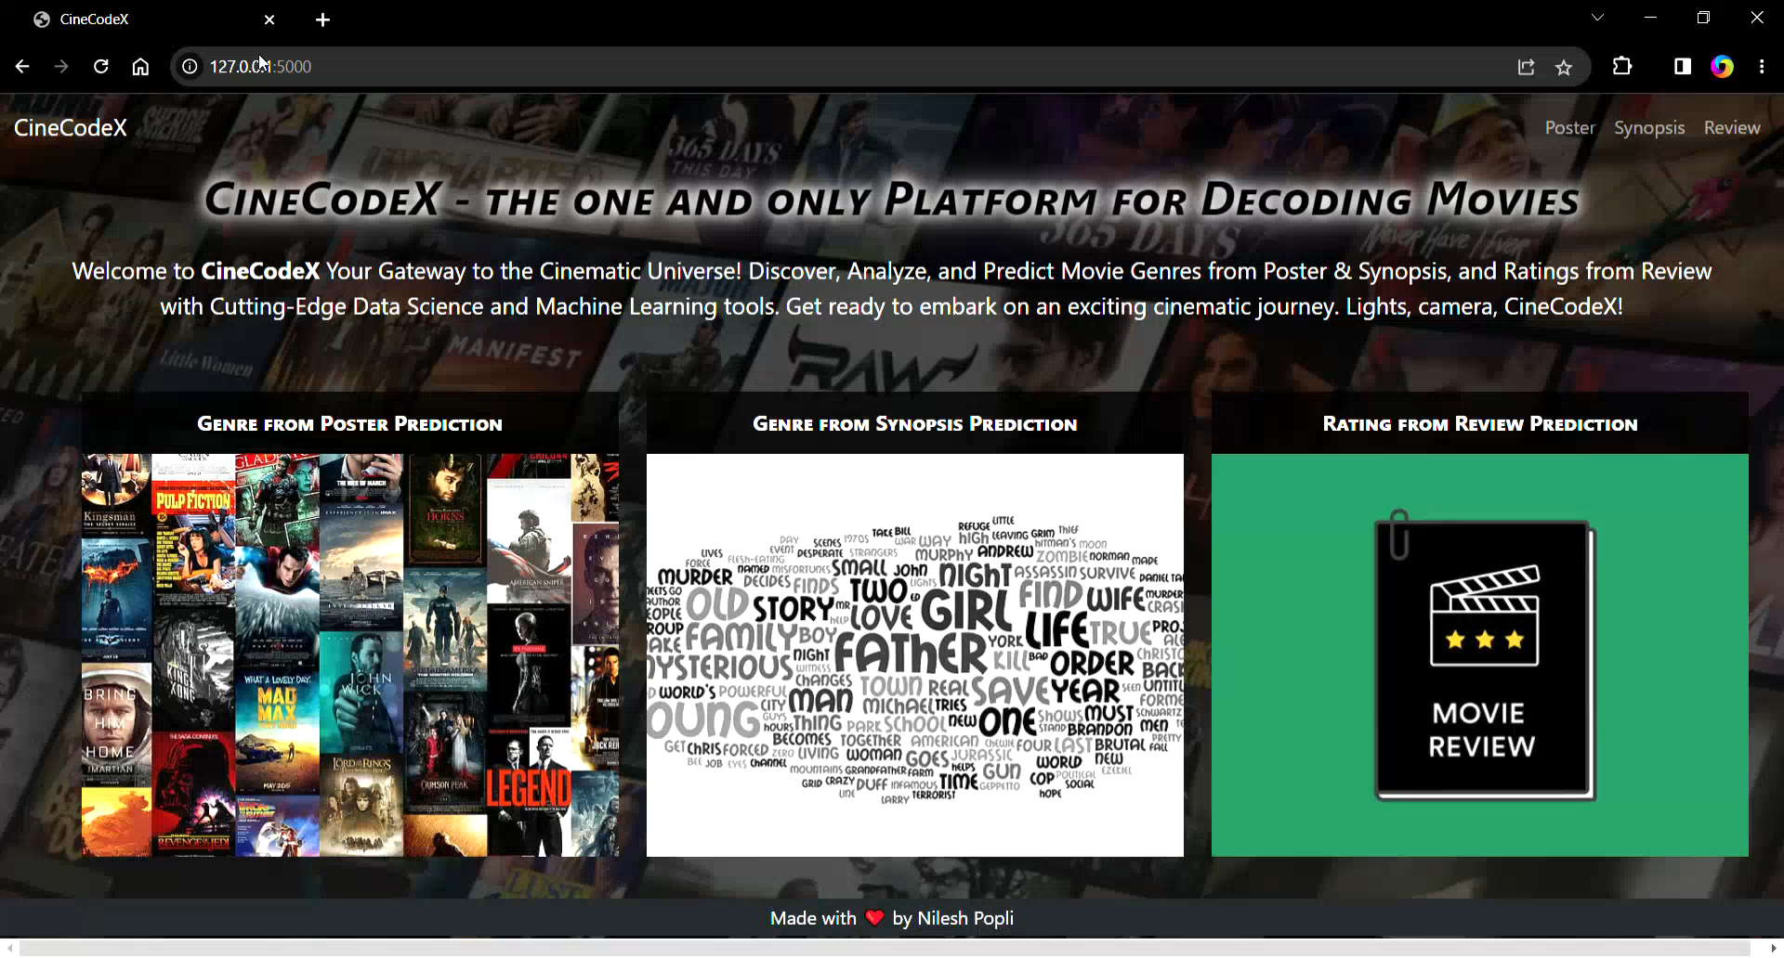
Demo

Slide 13
In this project, we successfully implemented a comprehensive methodology for movie data analysis and prediction.
Using the movie dataset, we proceeded to download the corresponding movie posters and store them for further analysis.
The trained model demonstrated promising results in accurately predicting genres, showcasing the potential of image analysis techniques in the realm of movie classification.
Moving forward, we extended our analysis to include movie synopses as another source of information for genre prediction.
Ensemble Methods: Investigate the potential of ensemble methods, such as model averaging or stacking, to combine the predictions of multiple models trained on different aspects of movie data (posters, synopses, reviews) for more robust and accurate genre prediction and rating estimation.
Allowed us to develop models capable of predicting movie ratings from reviews with reasonable accuracy.
Conclusion

Slide 14
While this project achieved significant milestones in movie data analysis and prediction, there are several avenues for future exploration and enhancement.
Enhanced Genre Prediction: Explore advanced deep learning architectures such as convolutional neural networks (CNNs) and transfer learning to improve genre prediction accuracy based on movie posters.
Fine-Grained Sentiment Analysis: Extend the rating prediction task to perform fine-grained sentiment analysis on movie reviews. Instead of predicting an overall rating, categorize reviews into sentiment categories such as positive, negative, or neutral.
User-Based Recommendations: Utilize the gathered movie data, including genres, ratings, and reviews, to build recommendation systems that offer personalized movie recommendations to users based on their preferences and viewing history.
Multi-Modal Analysis: Combine information from movie posters, synopses, and reviews to perform a multi-modal analysis, leveraging both visual and textual data for more accurate genre prediction and rating estimation.
Future Work

Slide 15
Thank You

